Slide 1
Sales Prediction For
Walmart Retail Goods
MSBA 6421 - Team Project
Shivani Vats, Trung Le, Vineeth Gorla,
Rithvik Bhonagiri, Yufei Shen
December 5th, 2023
University of Minnesota - Carlson School of Management

Slide 2
Prediction can bring business value to Walmart
Walmart’s challenge in forecasting
Benefits of sales prediction
Inaccurate predictions can result in substantial losses for Walmart
Traditional prediction methods are outdated, more new techniques are necessary
Avoid costly mistakes and improve forecasting accuracy
Efficient Inventory Management
Customer Satisfaction
Smart Promotions
Competitive Edge
Optimized Supply Chain
Support For Strategic Decision
Reduce Financial Risks
Raise Shareholder Confidence
……
University of Minnesota - Carlson School of Management

Slide 3
Prediction can bring business value to Walmart
Situation
Key Question
Walmart faces the task of maximizing decision-making efficiency with a rich dataset. Precise sales predictions becomes crucial to steer clear of both real and missed revenue opportunities
How to forecast daily sales for the next 28 days by using hierarchical sales data from Walmart?
Solution
Leverage machine learning for predicting future sales,
enhancing forecast accuracy in the process
University of Minnesota - Carlson School of Management

Slide 4
Exploratory Data Analysis
Raw Data | Description | # Feature | # Record | Data Size
calendar.csv | Workday & Special event day (e.g. SuperBowl) | 14 | 1.9 K | 103 kB
sell_prices.csv | Price of the products sold per store and date | 4 | 6.84 M | 203.4 MB
sales_train_validation.csv | historical daily unit sales data per product and store [d_1 - d_1913] | 1019 | 30.5 K | 120 MB
sales_train_evaluation.csv | sales [d_1 - d_1941] | 1047 | 30.5 K | 121.7 MB
University of Minnesota - Carlson School of Management

Slide 5
Walmart
State CA
State TX
State WI
Store CA1
Store CA2
Store CA3
Store CA4
Store TX1
Store TX2
Store TX3
Store WI1
Store WI2
Store WI3
Category Hobbies
Category Foods
Category Household
Dept Hobbies 1
Dept Hobbies 2
Dept Foods 1
Dept Foods 2
Dept Foods 3
Dept Househld 1
Dept Househld 2
Item 1…
Item 416
Item 417..
Item 565
Item 2003
Item 2534
Item 2789
Item 3049
……
University of Minnesota - Carlson School of Management
Notes:
Now let us quickly touch upon how are data looks like - So we have the information for 3 states namely CA TX and WI. For each of the those states there are 3-4 stores. Each store further have 3 broad categories namely Hobbies, foods and household. Which are further dissected into departments which have multiple items associated with it. Further we have the sells, prices for these items

Slide 6
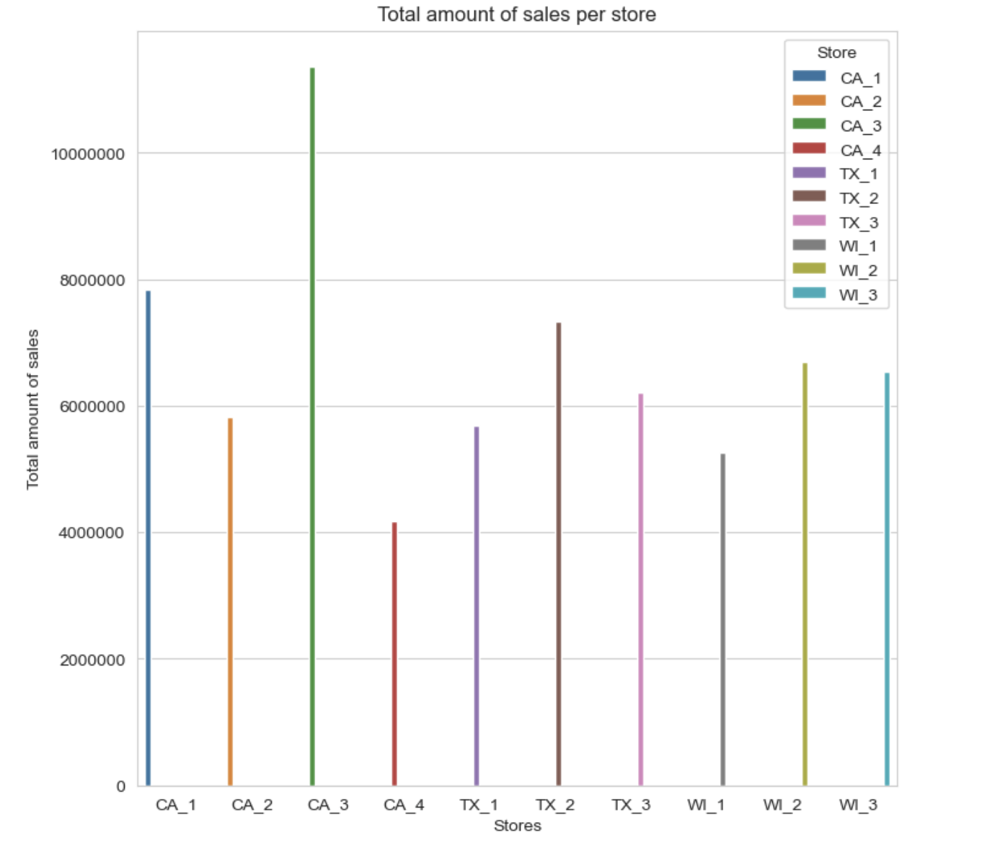
California has the maximum sales followed by Texas and Wisconsin
University of Minnesota - Carlson School of Management
Notes:
We observe california is the state which sells the most and also we can conclude that the foods category is by far the one that get the most sells in each state. Based on these observations we assume it will be useful to add the feature of total sales for each row since each row consists of a product of a certain category on a specific store

Slide 7
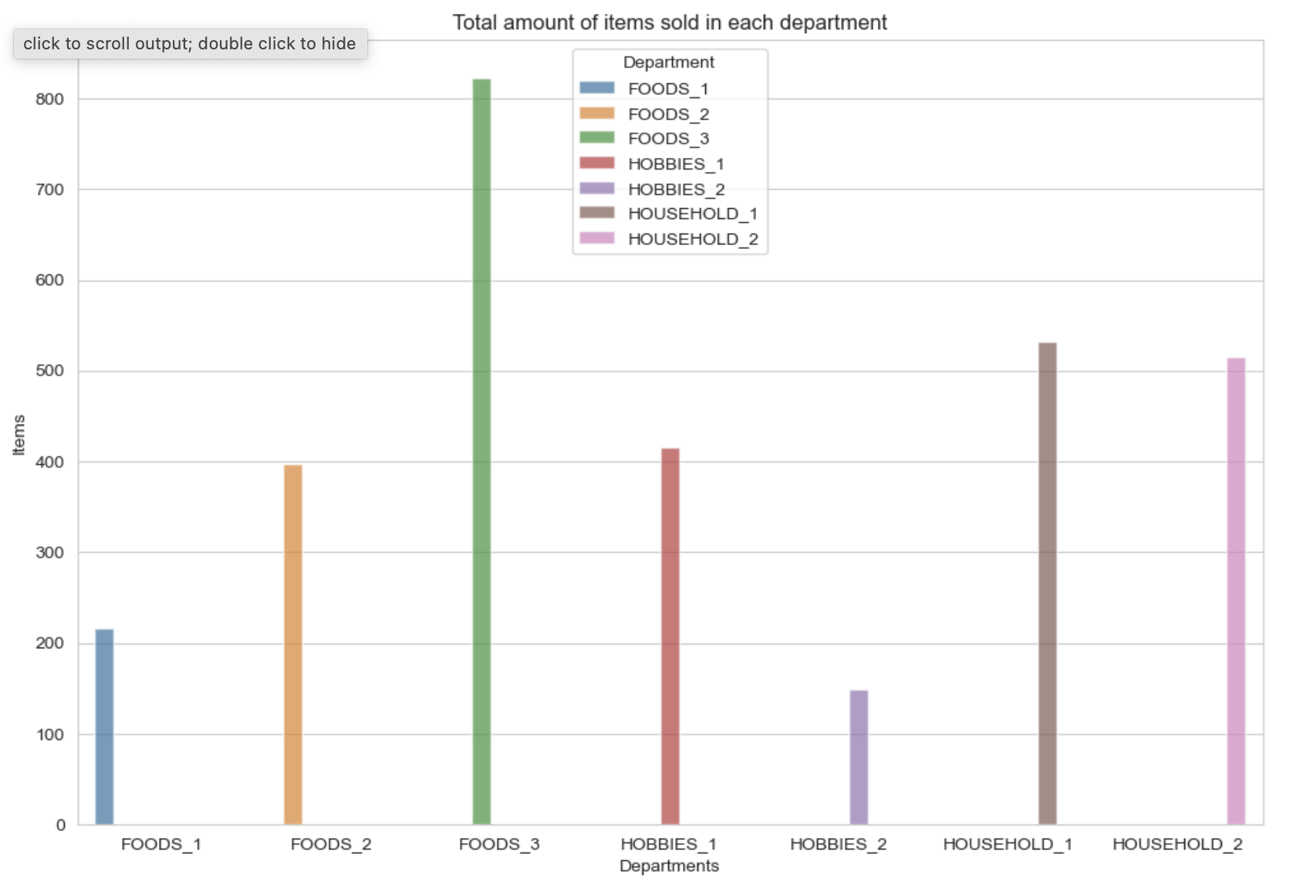
Food Category has the maximum sales
University of Minnesota - Carlson School of Management
Notes:
To see which departments have the maximum number of sales, we observes, one of the food departments has the maximum sales

Slide 8
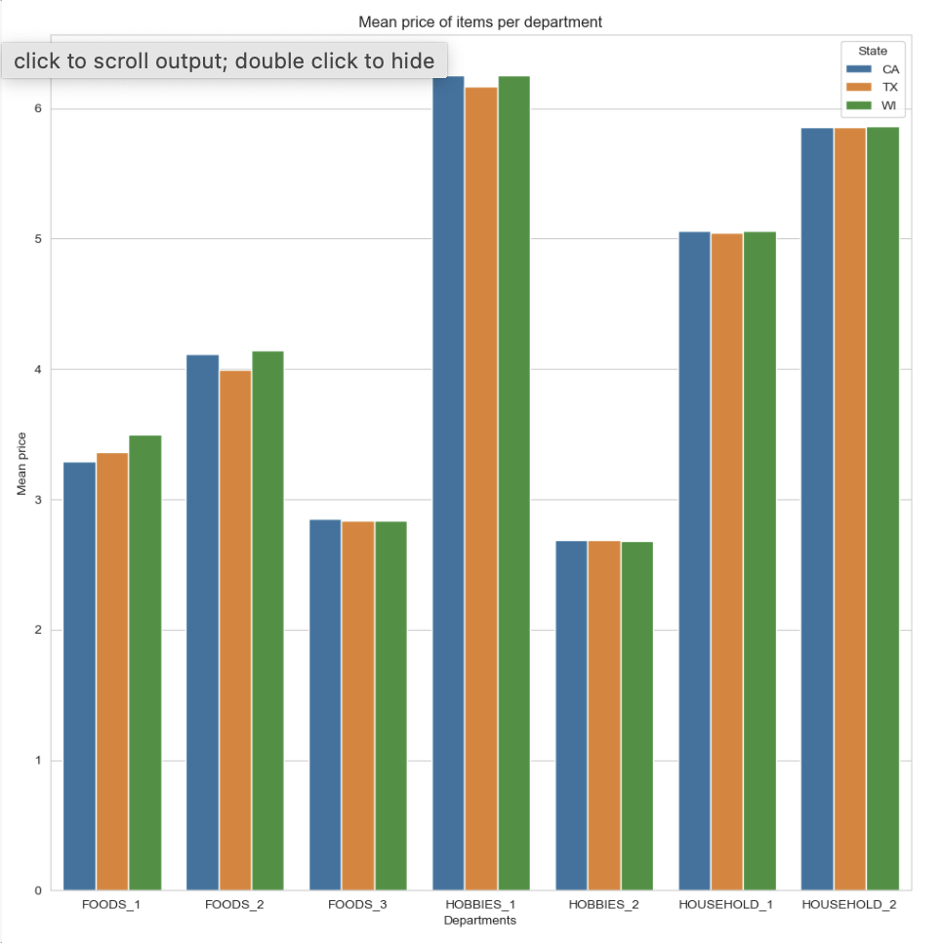
A sharp difference between Hobbies departments
University of Minnesota - Carlson School of Management
Notes:
Mean prices in the household and hobbies department tend to be higher than the food ones (HOBBIES_1 being the most expensive followed by HOUSEHOLD_2). We can also guess that california and winsconsin have the most expensive items in average. Finally, the number of sells per department, which can be visualized in the following plot, reinforces even more the initial hypotheses that the food sector is the one that sells the most and also the assumption that consumerism in california is higher (This could be due to the size of the states , which are: 38 million (CA), 25 million (TX), 5.7 million (WI)

Slide 9
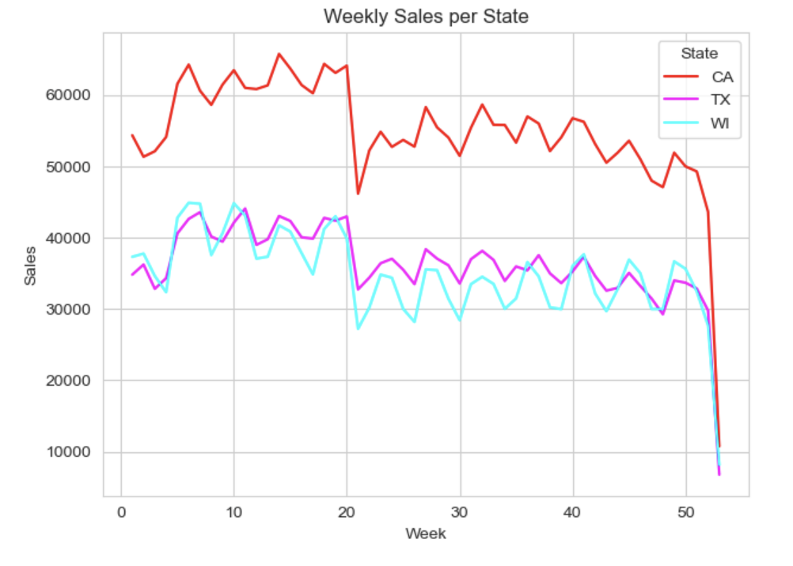
Weekends are the most profitable days of volume sold
University of Minnesota - Carlson School of Management
Notes:
It's obvious that the weekends are the most profitable days speaking of volume sold. Some states peak on different days of the week, such as winsconsin which drastically peaks and goes down on sundays (that detail right there tells us about the habits of people in winsconsin on where probably people prefer resting and spending time with the family rather than buying groceries at a walmart)

Slide 10
Feature Engineering
Calendar
Week days, months, years and events
Price
Expanding maximum, Expanding minimum, Expanding standard deviation of price, Expanding previous selling price
Leveraged Rolling Lags and Lags:
Rolling Lags -
a) Used window size 7, 14, 30, 60, 180 (In order to mimic weeks, months, year)
b) Rolling zero (it considers number of times sales were zero for a particular product)
c) Rolling standard deviation
d) Rolling mean difference (mean of sales difference per day in a particular window)
e) Maximum sales in a respective rolling window
Lag Value of Sales:
a) Lag ranging between 0 to 15 (to capture trends)
b) Categorical encoding of items, department, category, stores
c) Expanding mean of sales group by category, item, dept, store, [store, category], [ store, item id], and [store, dept id]
Sales
University of Minnesota - Carlson School of Management

Slide 11
Modeling
Step 1
Step 2 - Step 1
Days
Days
Days
Days
Pred Days
Pred Days
Pred Days
Pred Days
Step 1
Step 1
Step 2
Step 2
Example:
If we consider stps of 14 and 28
Iteration 1:
Step 1 = 14
For 14 days predictions will refer back to T-14 days.
Iteration 2:
Step 2= 28
For next 14 predictions (which is 28-14), my prediction steps increases from 2
Model will refer back to T-28 days.
Leveraged models -
Light GBM
XGBoost
Neural Network Model
Ensemble model of these 3 models
University of Minnesota - Carlson School of Management
Notes:
This way we will not be using predicted sales (which amplifies errors in time series forecasting)

Slide 12
Model Implementation
Then we run prediction model where we first loop over store and department to train the model (slow) , next over store and category (will be quicker) and take average of both these methods to arrive at final submission.
After features and methods were finalized, we decided to explore various regression algorithms.
For the purpose of this project we have chosen , LightGBM, XgBoost, Neural network, stacked model of lightgbm, xgboost, Neural Network regression models.
From the kaggle scores we found Light GBM was performing better than other models.
Hence, we chose to modify the prediction step size from [14, 28] to aggressive range of [7, 14, 21, 28] (compromising the speed ) and again ran Light GBM and got the best kept score.
University of Minnesota - Carlson School of Management

Slide 13
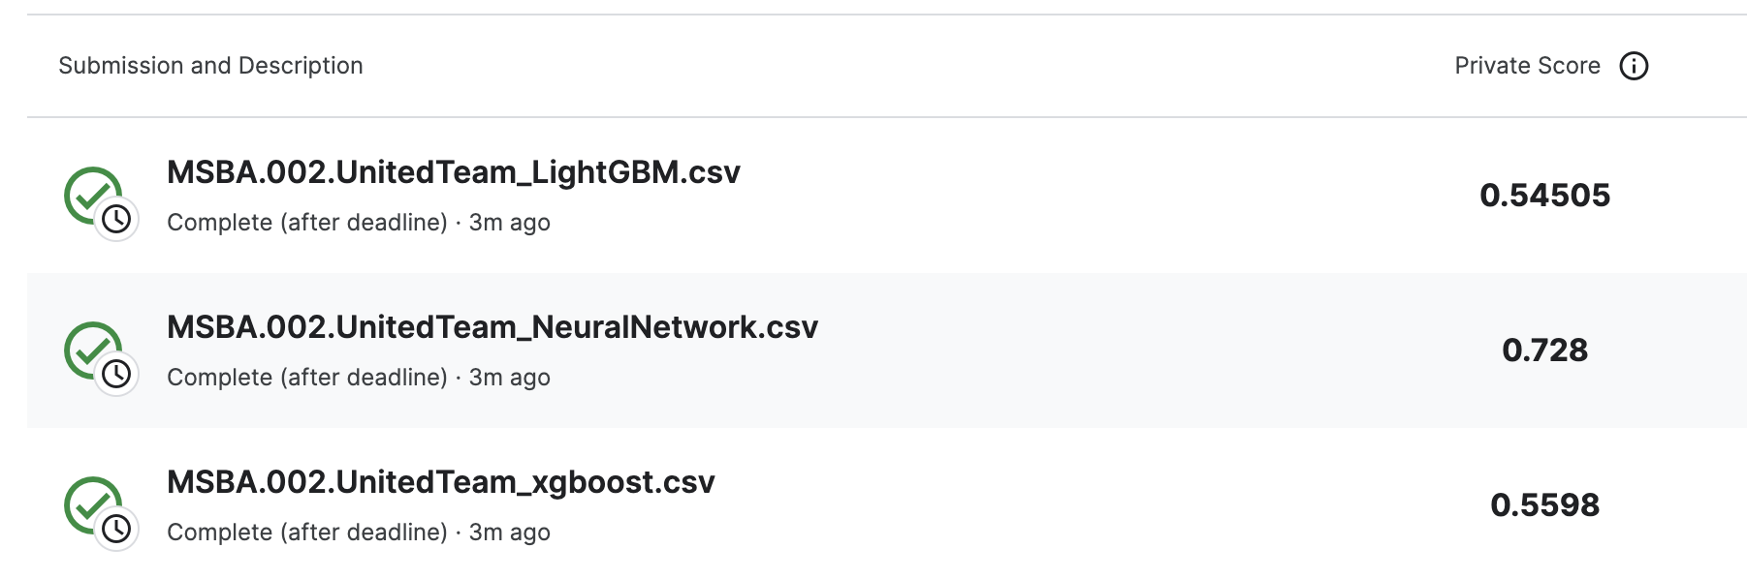
Result Interpretation
University of Minnesota - Carlson School of Management

Slide 14
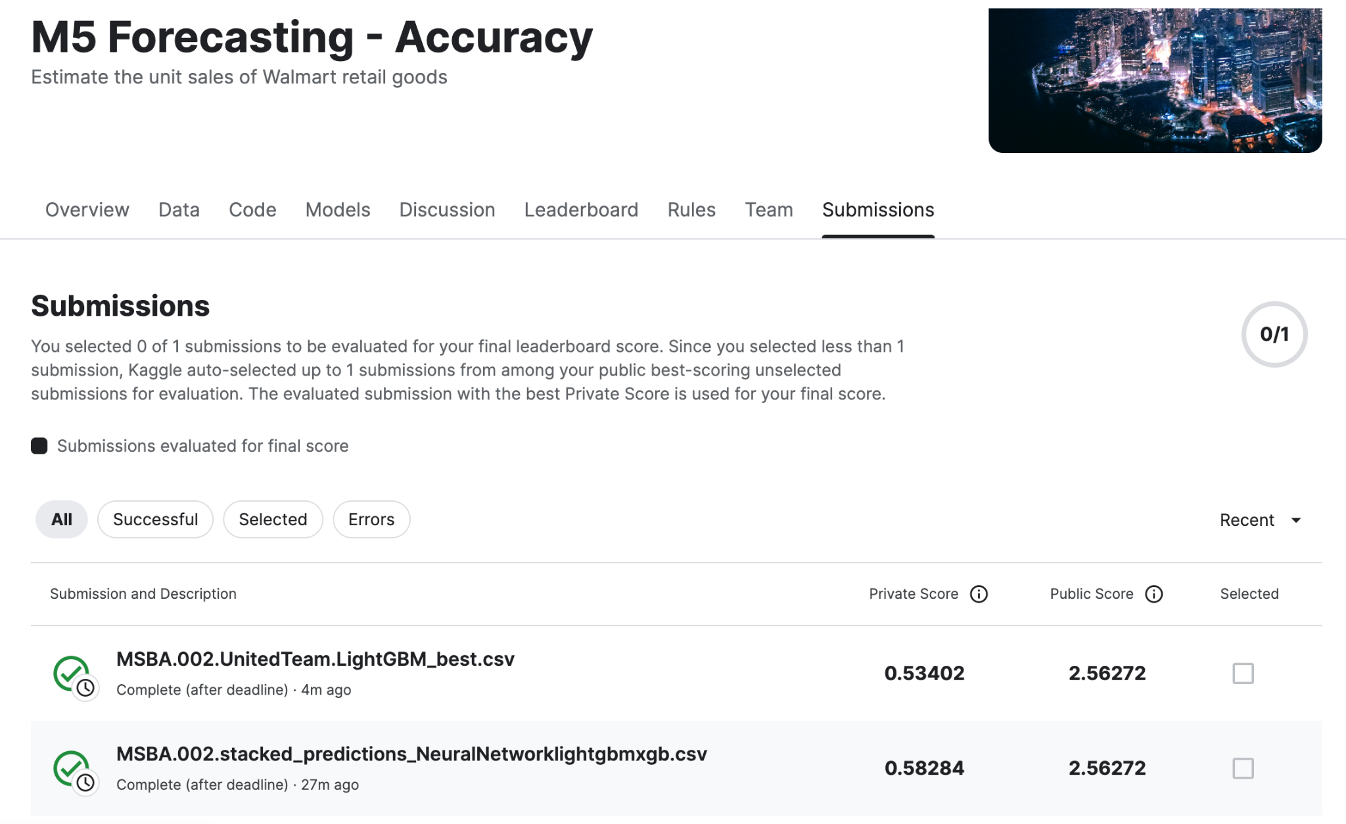
University of Minnesota - Carlson School of Management

Slide 15
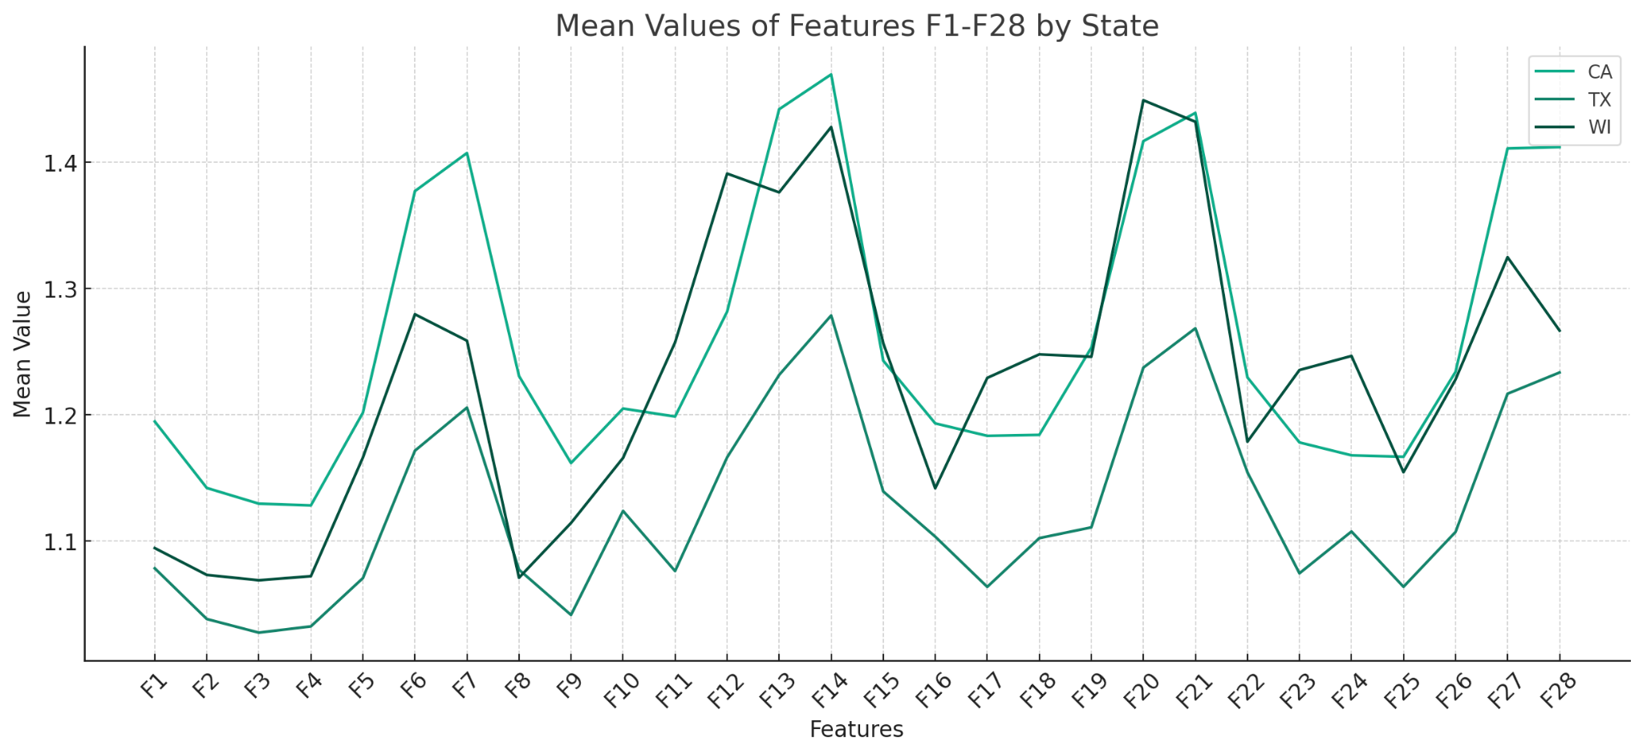
Findings from prediction result
In terms of average sales
Sales will be highest in California and lowest in Wisconsin
University of Minnesota - Carlson School of Management
Notes:
Such a fluctuating trend allows us to understand daily sales and make business decisions, such as reducing staff shifts to reduce salary expenses during low periods.

Slide 16
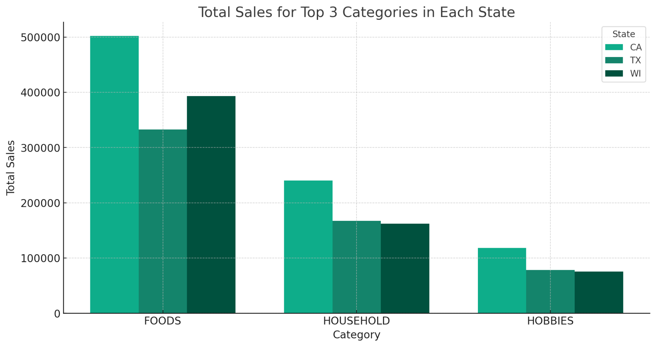
Findings from prediction result
In terms of total sales
Sales will be highest in Foods and lowest in Hobbies
Wisconsin has high food sales, low hobby sales
University of Minnesota - Carlson School of Management
Notes:
Ensure sufficient inventory and a healthy supply chain system for product category [Foods] among all these three regions. Especially for California, A 500 K unit of food inventory should be well-prepared in advance for the upcoming 28 days to meet the customer demand

Slide 17
Thank You!
University of Minnesota - Carlson School of Management

